Slide 1
Intel Group Power Capping
Intel Confidential and Shared Under NDA

Slide 2
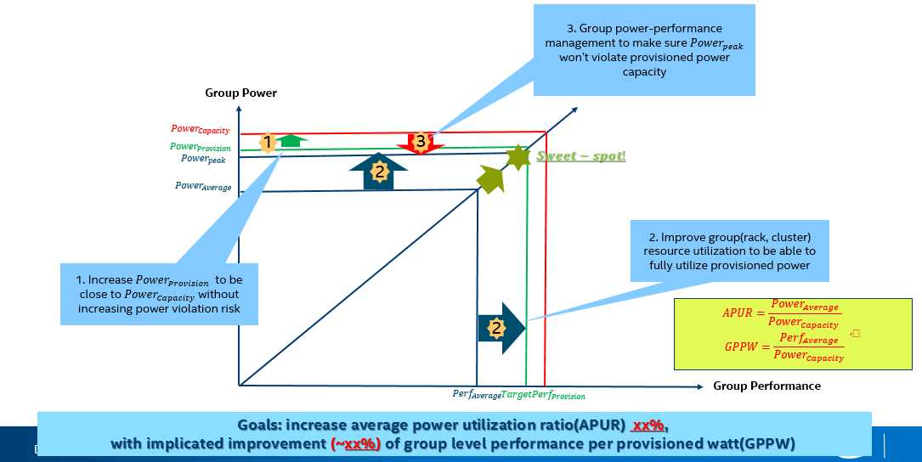
Group power performance
Shared under Intel - Inspur CNDA: 8980227

Slide 3
Power management hierarchy
We design a power management hierarchy based on the power delivery hierarchy in a typical modern data center. In this management hierarchy, there are 2 types of agent, node and group. A node represents a minimal unit (mostly a physical machine) that can be controlled and monitored by its parent group, and a group can control its children nodes and its sub-groups using our power management algorithm. Figure 1 shows a power management hierarchy tree of a typical data center.
Shared under Intel - Inspur CNDA: 8980227

Slide 4
Intel Group Power Control (GPC) Reference Solution
Orchestration and DCM Algorithms: PAS, ITM etc.
Openstack
K8S
DCM
Matrix HAS
(Baidu)
Tianji
(Ali)
Alpha quality reference module to support quick prototype at CSP environment
Reference design guide, algorithms, BKM for CSP customization
Provide workload generator to simulate power runtime pattern according to historical data
Rick PnP telemetry and control capability support on IA platform
API (Restful, e.g. Redfish)
API Spec. And Redfish alignment
Workload Generator
Group level Controller Agent
GPC Control algorithms: Power capping, cluster P-states management, dynamic CCx mgmt.
Shared under Intel - Inspur CNDA: 8980227
Controller node
Restful
IPMI
Restful
Telemetry:
System power, Resource utilization, temperature
Worker node
Intel Power Telemetry and Management SDK
NM 4.0
Operation System
Control knobs:
RAPL, NM, Legacy P, HWP, CCx
Hardware
Intel BKM, Algorithms, Design Guide, Spec.
Intel Reference Codes

Slide 5
Power management algorithm
Shared under Intel - Inspur CNDA: 8980227

Slide 6
Terminology
Actual Power: Actual power consumption of group/node. For a physical machine node, this value can be obtained by NM/RAPL/ACPI/Power Meter. For a group, this value can be obtained by count of children’s Actual Power or Power Meter.
Power Capacity: The power budget of group/node. For head-group, this value is set by the admin, for others, this value is allocated by its parent. For any controller, insurance of the Actual Power under the Power Capacity takes the 1st priority in our algorithm.
Power Provision: The power that a group/node can actual use. For a node, it’s the capping value, for a parent group, it’s the power that it can allocate to its children.
Default Power: A value that represents the power level of baseline performance, a child’s Default Power is calculated is calculated by its parents through its priority, the sum of all children’s default power equals to parent’s Power Provision. The application from any child to parent to get its default power takes the 2nd priority in our algorithm.
Power Pool: A pool that contains the unused power budget.
Shared under Intel - Inspur CNDA: 8980227

Slide 7
Terminology
Time Interval: The interval of power control time, and the time interval is different between different control-level.
Power Action: When there is a need for node or group to adjust its power budget, it will apply for a power action from its parent. If a power action is approved, for node, it will change its power capping value; for group, it will reallocated power to its children.
Power Action Margin: a value that，when the Actual Power reach the line (Power Provision - Power Action Margin), it triggers a power action.
Shared under Intel - Inspur CNDA: 8980227

Slide 8
Power consumption prediction & power pre-allocation
By now there is no method to mapping complex workloads and power consumption computing cluster, the types of workloads are relatively stable, which means the prediction and power pre-allocation based on the time-series data of Actual Pow We import 2 time-window to do prediction: long-window and short-window.
Under two situations a child will try to apply for more power from its parent:
Avg(short-window) > Avg(long window)+△ (2-1)
Actual Power > Power Provision - Power Action Margin (2-2)
Where △ is a set value to block noise, and there is a cooling-off period (same to long time
window time period in our example) for this in order to avoid re-trigger in a short period.
Shared under Intel - Inspur CNDA: 8980227

Slide 9
Power Pool
Any group in our power management system has a power pool to collect power unused from its children, when there is a child apply for a Power Action to get more power budget, its parent will allocate power to it from the Power Pool rapidly. When the Power Pool have no enough power, the parent will make a decision to judge whether make a power repossession from other children according to the Default Power (which is calculated by priority). To decide whether a child has power unused, we use Max(long window), for a child when:
Max(long window) < Power Provision - Power Action Margin +△ (2-3)
Power from child to parent and the new Power Provision of the node:
Power to parent = Power Provision - Power Action Margin -Max(long window) (2-4)
New Power Provision = Max(long window) + Power Action Margin (2-5)
Where △ is a set value to block noise
Shared under Intel - Inspur CNDA: 8980227

Slide 10
Priority and Default Power allocation
In our power management, when all children try to get power from parents and there is no enough power to allocate, which is the worst case. Parent will make all children running under its default power, Default power of child k is: Default power 的公式:
Child Default Powerk = Baselinek +
[Parent Power Provision – Sum(Baseline)]×priorityk/Sum(priority) (2-6)
Where BaseLine and Priority shall be decided by workload type, server type and admin.
Parent Power Provision = Sum(Child Default Power) (2-7)
So when a child apply for a Power Action to get the budget of its Default Power, it can always be satisfied, if the Power Pool of its parent has no power budget, the parent controller will repossess power from other child who’s Power Provision > Default Power and then sanctify the Power Action
Shared under Intel - Inspur CNDA: 8980227

Slide 11
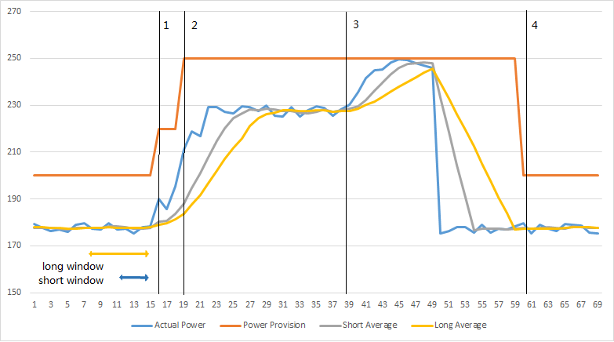
Borrow & Lend power budget to power pool
Power Pool
Shared under Intel - Inspur CNDA: 8980227
Sample interval：1s
Notes:
we show a power management example where control interval is 1s, short window interval is 5s, long window interval is 10s, the node’s Default Power is 250W and △ is 5W. At time point 1, (2-1) is satisfied, so the child try to get more power budget from its parent, with approval, its Power Provision rises. At time point 2, (2-2) is satisfied, so the child try to get more power budget from its parent, with approval, its Power Provision rises. At time point 3, (2-1) and (2-2) is satisfied, so the child try to get more power budget from its parent, its Default power is 250W and its parent have no more power, so it cannot get more power budget and its Power Provision remain unchanged. As a node, it’s capped. At time point 4, (2-3) is satisfied, so the child give its unused power budget to its parent and its Provision power decreases.

Slide 12
Group Power Management Strategies/Policy
Strategies | Description | Comments
Static Power Capping | Rack controller capping nodes through node manager. But static power allocating will result in that some nodes reach power capping line while there is still power margin within the rack which results in worse group performance power per watt (GPPW). | Pros: No power violation. Cons: High performance impact. Low APUR & GPPW.
Conservative Dynamic Power Capping | Rack controller monitors nodes’ power consumption and reallocates power as workloads change over time. Rack controller capping nodes through node manager in real time. In configuration list, cap_always = yes | Pros: Minimum power violation. Cons: Medium performance impact.
Performance- Aggressive Dynamic Power Capping | Rack controller monitors nodes’ power consumption and reallocates power as workloads change over time. Rack controller capping nodes through node manager only when rack overall power consumption exceeds its capacity to get the max performance, but it may cause peak transient rack power. In configuration list, cap_always = no | Pros: Low performance impact, especially fit to the scenario where workload in different servers has different peak traffic time. Cons: Potential power budget violation with limited over-shooting
Shared under Intel - Inspur CNDA: 8980227

Slide 13
GPC-ARCH/FLOW
Shared under Intel - Inspur CNDA: 8980227

Slide 14
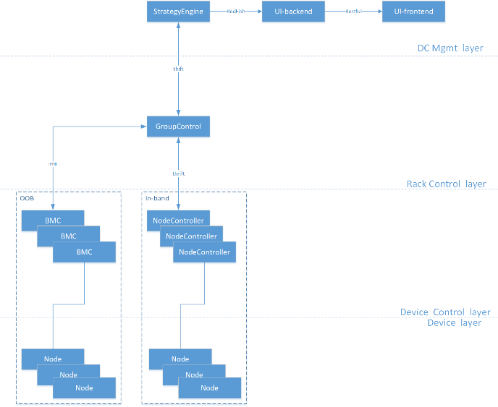
GPC - Arch
Shared under Intel - Inspur CNDA: 8980227

Slide 15
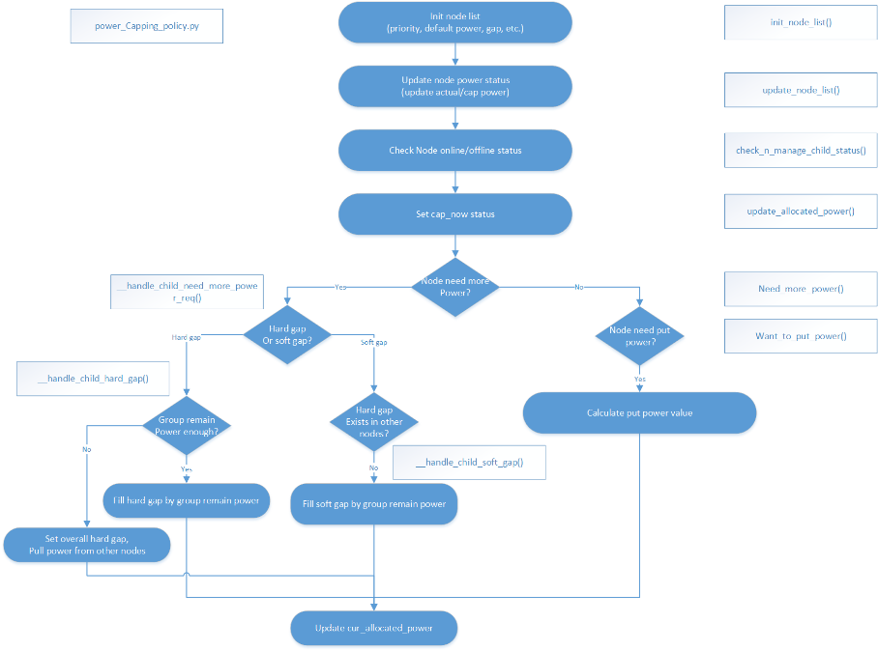
GPC-Power Capping Flow
Shared under Intel - Inspur CNDA: 8980227

Slide 16
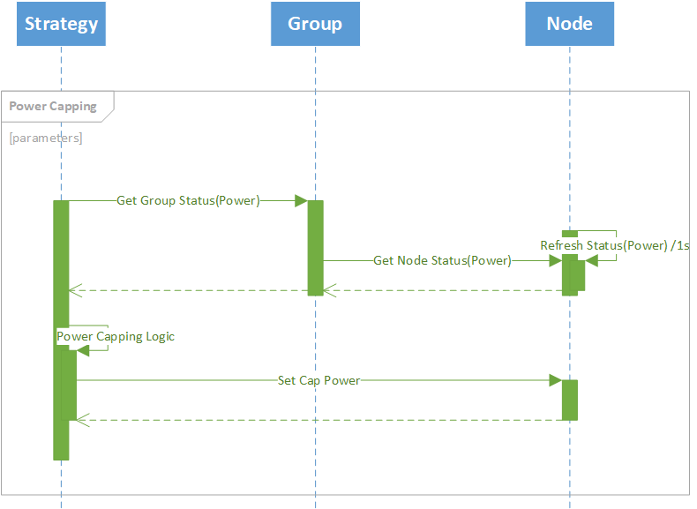
GPC-Power Capping Sequence
Shared under Intel - Inspur CNDA: 8980227

Slide 17
Power management Test Report
Shared under Intel - Inspur CNDA: 8980227

Slide 18
Case Study - Group Power Capping Evaluation
Background – One cloud service provider suffering from rack density and power over budget warning, the group power capping is enabled and we evaluated typical workload^{[1]} for capping and uncapping with different density incremental assumptions.
UCs- S1: The normal condition, no desnity improment as baseline. S2: The rack runs in higher density with power violation, but no capping. S3: The rack runs in higher density with power capping.
Result: Power capping system can protect the rack from contiuning power violation with limitted performance degradation while increasing rack density, e.g. under 18% rack density improment, the performance downgradtion is <=3% and energy capped ratio is 1% .
[1] - Random select 24h data and resample to 2h for test. 12 servers are for workload test
Shared under Intel - Inspur CNDA: 8980227
Scenario | Density | Strategy | Power Consumption | Performance | Peak Power | Average Power | Capped energy | Perf. Degradation
S1 | 1 | - | - | - | 7898 | 7056 | - | -
S2 | 1.18 | Uncapping | 15256740 | 23524956.1 | 8676 | 8339
S3 | 1.18 | Capping | 15096960 | 22803198.3 | 8596 | 8265 | 1.0473% | 3.0681%
S2 | 1.25 | Uncapping | 15640260 | 36616505.8 | 8505 | 8148
S3 | 1.25 | Capping | 15379220 | 34898682.8 | 8501 | 8310 | 1.6690% | 4.6914%

Slide 19

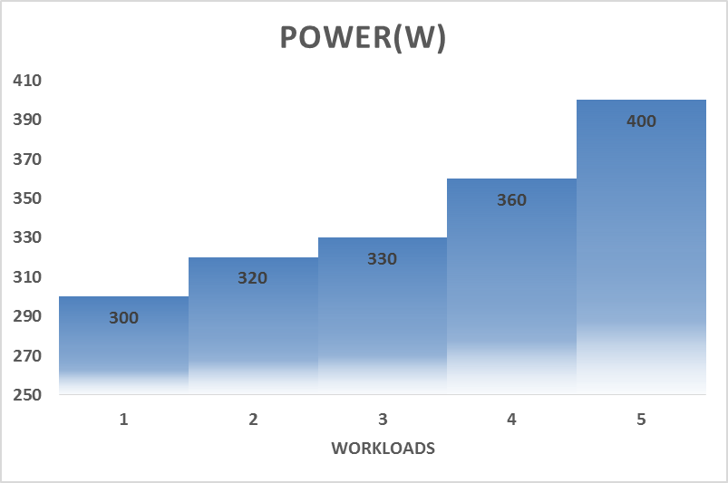
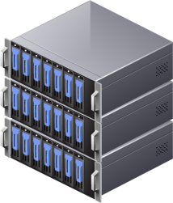

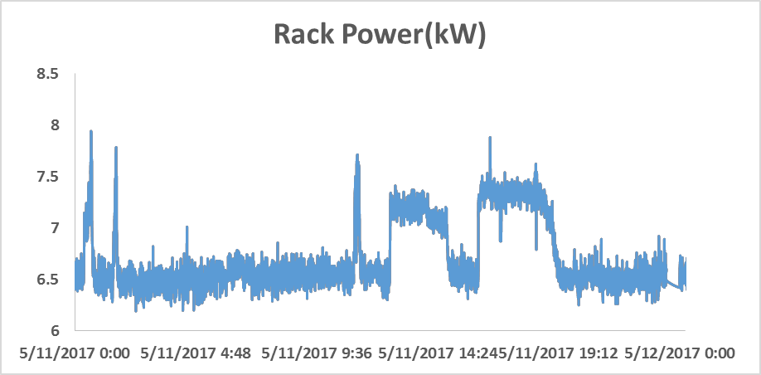
Workload Simulation Tool (Power) – Page 1
Node-level workload-power relationships are known
With targeted rack power, the workload generator generates different workloads for every node
All the nodes give out the targeted rack power
Shared under Intel - Inspur CNDA: 8980227
Workload Generator

Slide 20
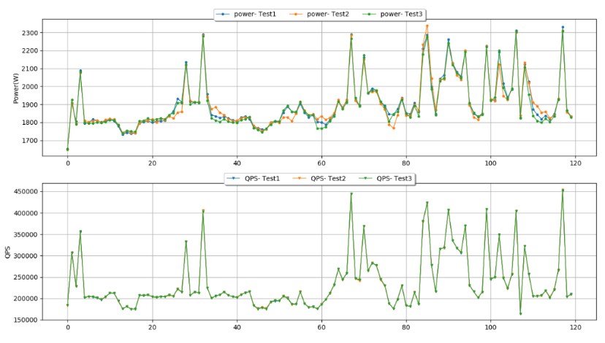
Workload Simulation Tool (Power) Page-2
TestID | Performance | Power(w*s) | Performance variance | Power variance
Test1 | 28393673 | 228364 | Baseline | Baseline
Test2 | 28399655 | 228053 | 0.34% | 1.21%
Test3 | 28396240 | 227532 | 0.30% | 0.08%
Shared under Intel - Inspur CNDA: 8980227
It is necessary to evaluation the benefit of Power capping and DRPP with a high accuracy tool.
The workload simulation tool has low variances:
Performance variance 0.3%
Power variance about 1%

Slide 22
Power management SPECIAL Case
Shared under Intel - Inspur CNDA: 8980227

Slide 23
For node lose control
1. If the node support power-capping and under our power management system:
Give the node a power budget the system allocate to it last-time and the node will maintain this budget until its reconnection.
2. If the node not support power-capping and cannot controlled by our power management system:
Give the node a power budget of its TDP.
Shared under Intel - Inspur CNDA: 8980227

Slide 24
Performance Impact:
A small reduction in power achieved through existing power capping methods can cause the application latency to increase uncontrollably and may even reduce throughput to zero. (risk evaluation)
Additionally, even the observed peak is only reached rarely. To avoid provisioning for capacity that will be left unused most of the time, data centers may provision for the 99th percentile of the peak power. Capping would be required for 1% of the time, which may be an acceptable hit on performance in relation to cost savings.
Shared under Intel - Inspur CNDA: 8980227

